Slide 1
Inception Deck
By: Charmaine, Shane, Sharon and Vin Hee
Notes:
speaker: charmaine

Slide 2
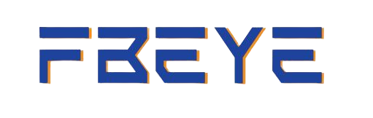

Sponsored by
Notes:
speaker: charmaine

Slide 3
Team Members
# | NAME | COMPETENCIES
1 | Hei Yee Shane | Scrum Master
2 | Woon Vin Hee | Developer
3 | Phang Kah Yeng | Developer
4 | Cheng Jia Wen Charmaine | Developer

Slide 4
The Team
Role | Competencies/Expectations
Scrum Master | Responsible for outward facing communication Status reports, scope, budget, and reporting upwards
Developer | C#, MVC.NET, SQL, Python Develops Web Application
UI/UX Designer | Responsible for the design of the user interface Makes sure that the interface is user friendly and visually pleasing
Notes:
speaker: sharon

Slide 5
Why Are We Here
Enhanced Attendance Management:
Develop a robust facial recognition system to improve the efficiency of attendance tracking in various settings.
Improve Security and Accountability:
Contribute to enhanced security by accurately tracking who is present at a given location.
Reduce Fraud and Manual Errors:
Minimize risk of attendance fraud, virtually eliminating human errors in attendance-taking.
Notes:
speaker: charmaine

Slide 6

To provide an efficient attendance taking method for the employees
Notes:
speaker: charmaine

Slide 7
Elevator Pitch
For:
AIDC Group Pte Ltd
That:
Takes Attendance
Who:
Employees of AIDC
Unlike:
RFID cards
What:
A Data Collection Software
Uses:
Facial Recognition to track employees
Notes:
Hello, I'm excited to introduce you to FBEye, a cutting-edge solution revolutionizing employee attendance tracking. Traditional methods like RFID cards can be a hassle, often leading to inefficiencies and potential errors. With FBEye, we've harnessed the power of facial recognition to streamline the process. Our software seamlessly captures attendance data for AIDC employees, making the cumbersome use of cards a thing of the past.
Imagine a world where time-consuming manual check-ins are replaced by a quick and secure facial recognition scan. FBEye not only enhances efficiency but also ensures accuracy in attendance records. The simplicity of our solution translates into saved time and increased productivity for your organization.
FBEye goes beyond just data collection; it's a robust tool designed to meet the evolving needs of modern businesses. Our software is user-friendly, scalable, and customizable, allowing you to effortlessly integrate it into your existing systems.
In a world where every moment counts, FBEye empowers your organization to focus on what truly matters - achieving your goals. Experience the future of attendance tracking with FBEye, where innovation meets simplicity. Elevate your workforce management with FBEye today!"
speaker: charmaine

Slide 8



Elevator Pitch
Unlike RFID Cards
Quick & Secure facial recognition scan
Efficient & Accurate
attendance records
Notes:
Hello, I'm excited to introduce you to FBEye, a cutting-edge solution revolutionizing employee attendance tracking. Traditional methods like RFID cards can be a hassle, often leading to inefficiencies and potential errors. With FBEye, we've harnessed the power of facial recognition to streamline the process. Our software seamlessly captures attendance data for AIDC employees, making the cumbersome use of cards a thing of the past.
Imagine a world where time-consuming manual check-ins are replaced by a quick and secure facial recognition scan. FBEye not only enhances efficiency but also ensures accuracy in attendance records. The simplicity of our solution translates into saved time and increased productivity for your organization.
FBEye goes beyond just data collection; it's a robust tool designed to meet the evolving needs of modern businesses. Our software is user-friendly, scalable, and customizable, allowing you to effortlessly integrate it into your existing systems.
In a world where every moment counts, FBEye empowers your organization to focus on what truly matters - achieving your goals. Experience the future of attendance tracking with FBEye, where innovation meets simplicity. Elevate your workforce management with FBEye today!"
speaker: charmaine

Slide 9
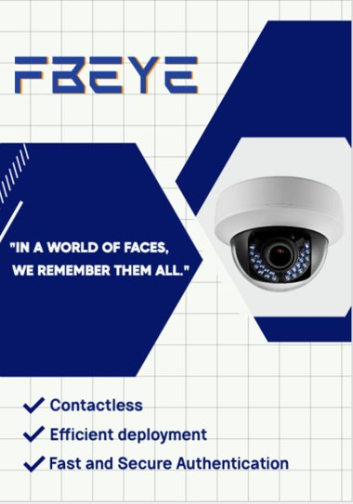
Product Box
Notes:
speaker: sharon

Slide 10
IN SCOPE | OUT of SCOPE
Facial Recognition | Registering and managing domain
Calculation of Salary
Email Notification System
Web Application to submit status (MC/Leave)
UNRESOLVED
Mobile App
Track all security guards' patrol route
Notes:
Speaker: shane

Slide 11
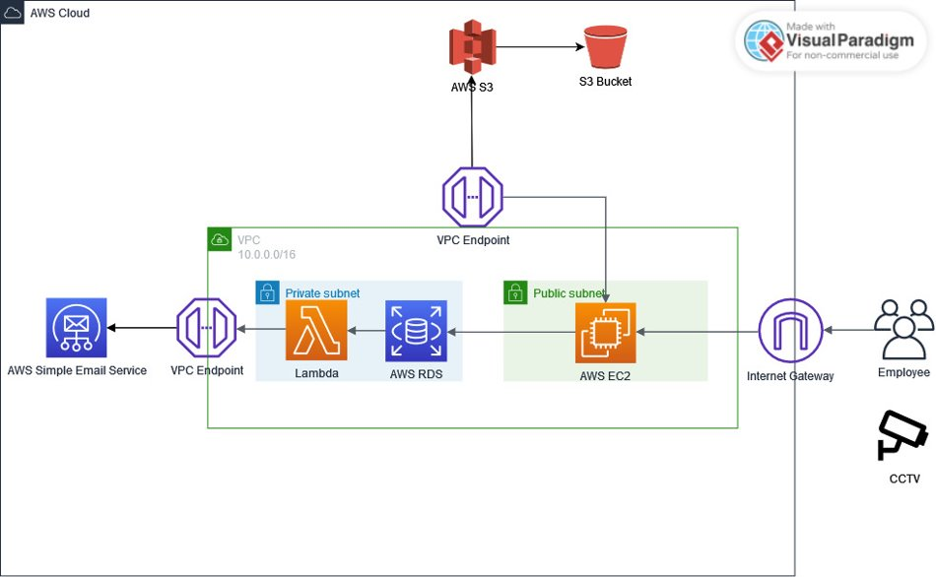
Our Technical Solution
Technologies:
Python
HTML, CSS, JS
Cv2, cmake
Camera/CCTV
Notes:
speaker: shane
Technologies:
Python, HTML
Cv2, cmake
Camera/CCTV

Slide 12
What keeps us up at night?
Debugging and Testing
Meeting Deadlines
Not having a co-located team
Availability of the customer
Notes:
speaker: sharon

Slide 13



Our Project Community
Lecturers
Sponsors
Classmates
Notes:
speaker: vinhee

Slide 14

How big is this thing?
Construction
UAT
Training
~2 ½ months
1 wk
1 wk
4 People, 3 Months, 100k
Notes:
speaker: vinhee

Slide 15
Trade-off Sliders
 | The classic four
 | Feature Completeness (scope)
 | Stay Within Budget (budget)
 | Deliver Project on Time (time)
 | High Quality, Low Defects (quality)
1
5
1
5
1
5
1
5
 | Other Important Things
 | Ease of Use
 | Don't Make Me Think!
 | Detailed Audits (log everything)
1
5
1
5
1
5
Notes:
speaker: vinhee

Slide 16
Our challenges
Developing a responsive and visually pleasing website
Configure Firebase (Connecting to camera etc.)
Connecting all project together (firebase, website, camera)

Slide 17
Completed product increments
Sprint 1
Sprint 2
Homepage
Login
Firebase Set Up
Forget Password
Upload Photo
Attendance Records Table
Retrieve data from Real-Time database in Firebase

Slide 18
Plan for future features
Mobile Application
View Real-time Live Camera
Employers can view the live camera so that they can address attendance lateness/attendance issues
Employees are able to access to both the web services and mobile application for efficiency purposes

Slide 19
Thank You!
Notes:
speaker: vinhee

Slide 20
Q&A
Notes:
speaker: vinhee

Slide 21
Thanks!
Do you have any questions?
Please keep this slide for attribution
Notes:
DO NOT DELETE, FOR CREDITS

